Slide 1
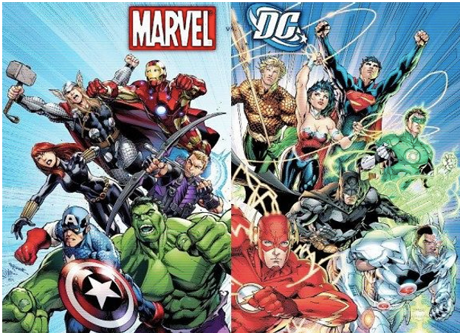
Marvel vs DC Universe
Project 1
Nate Savage, Frenci De la Cruz, Drew Bollinger, Nikki Alfrey
Image Credit: https://www.clarendonhousebooks.com/single-post/why-dc-can-never-hope-to-emulate-marvel-in-the-cinema

Slide 2
Project 1: Marvel vs DC Universe
Most people have a favorite superhero and version of that superhero, which leads one to ask, which is better, Marvel or DC Universe? How do you determine which is better?
We used a dataset to review budgets, profits, character leads, length of films, and Rotten Tomato scores to help us determine a universe that is super-ior.

Slide 3
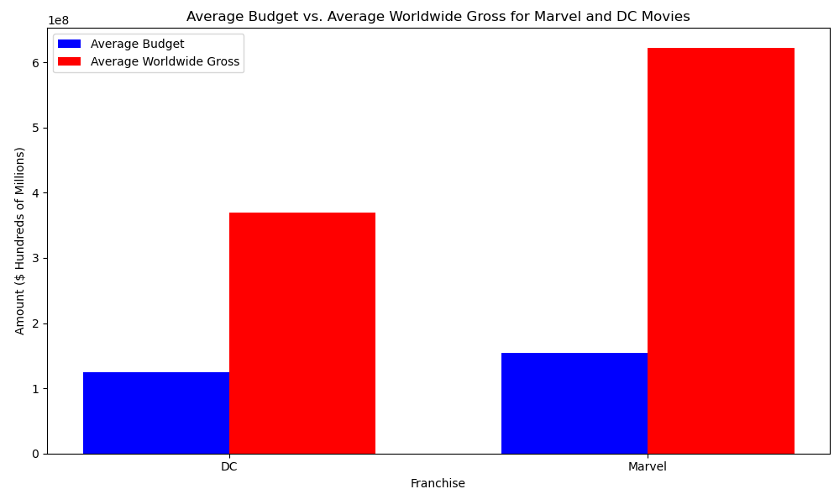
What relationship does budget have to box-office worldwide profits? Does franchise have a defining factor in gross worldwide profits? DC’s average budget is $124.6M Marvel’s average budget is $154.6M

Slide 4
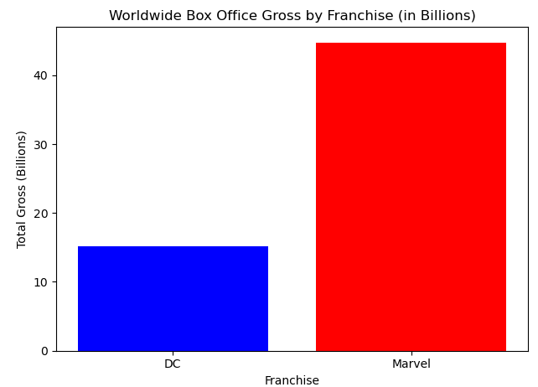
How do the two franchises compare in terms of profitability? DC’s average box office gross is $369.2M Marvel’s average box office gross is $621.6M DC nets 2.9 times the budget (profitability). Marvel nets 4.2 times the budget (profitability).

Slide 5
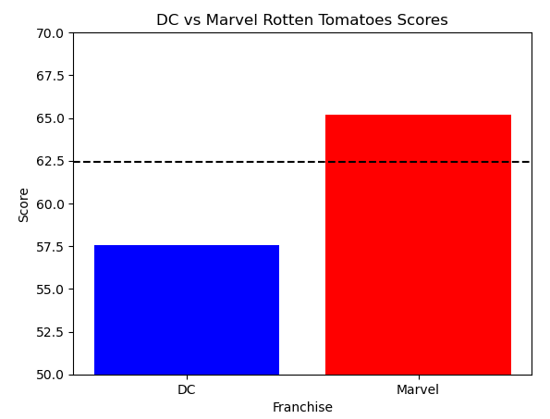
What is the average Rotten Tomato Score for each franchise's films? DC returns a mean Rotten Tomato Score of 57.56 and Marvel returns a Rotten Tomato Score of 65.21

Slide 6
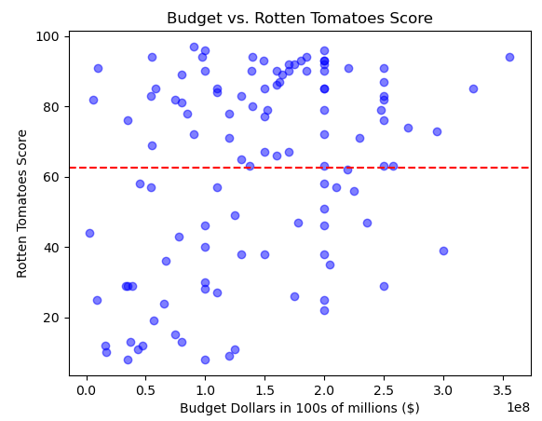
What is the effect of the film budget on the Rotten Tomato Score? $150M-$190M nets a higher Rotten Tomato Score than budgets over $200M. Once budgets are greater than $250M the Rotten Tomato Score increases. Under $100M scores are lower.

Slide 7
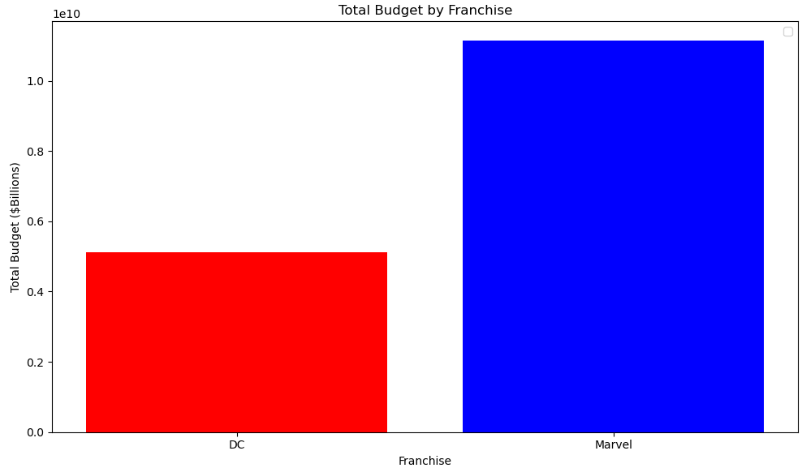
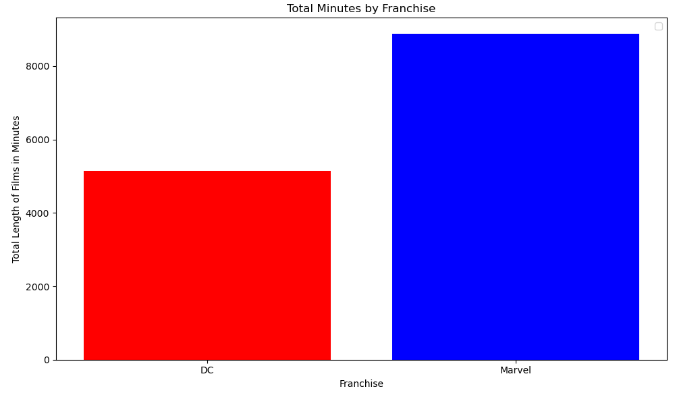
Does the budget set for the film affect the length of the film, in minutes? DC spends approximately $990k per minute to produce a film. Marvel spends approximately $1.3M per minute to produce a film

Slide 8
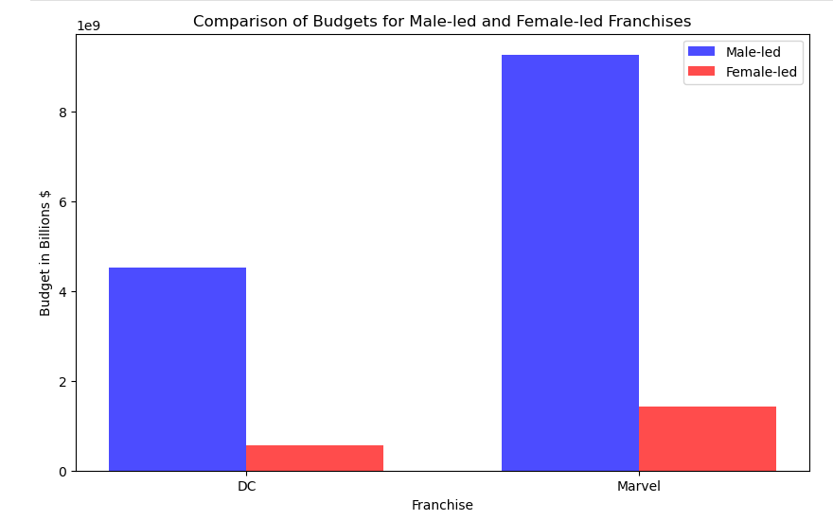
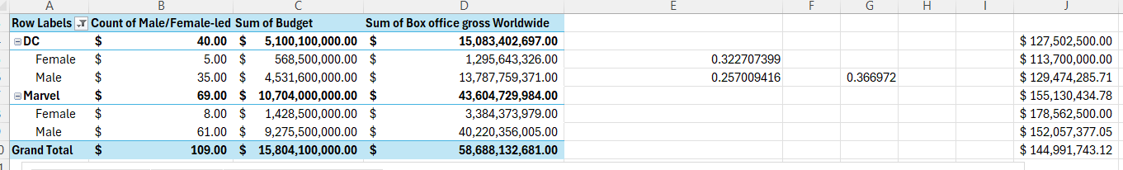
Does the main character lead (Male or Female) affect the budget? Out of 109 films 37% are led by females, 63% are led by males.

Slide 9
Which is Super-ior?
Marvel is Super-ior budget and films
Marvel may spend more money per minute to produce a film, however they net a higher profitability compared to their budget and have higher rotten tomato scores.

Slide 10
Citations
https://www.kaggle.com/datasets/willianoliveiragibin/marvel-vs-dc
https://www.kaggle.com/datasets/jcraggy/marvel-vs-dc-imdb-rotten-tomatoes
https://www.kaggle.com/datasets/darrylljk/marvel-cinematic-universe-films-box-office
https://www.kaggle.com/datasets/davidgdong/marvel-cinematic-universe-box-office-dataset
https://www.kaggle.com/datasets/mdtoomey/box-office-of-dc-and-marvel-superhero-movies
https://www.kaggle.com/code/cliomaciel/eda-dc-marvel/notebook

